Slide 1
Basics of Electronics and Communication

Slide 2
Course outcomes
Apply the knowledge of working principle of diode for utilization in different applications
Apply the knowledge of working principle of transistor for utilization in different applications.
Understand the basic concept of feedback in amplifiers and applying for designing LC and RC oscillators.

Slide 3
Comprehend the basic concept of Binary Number System and apply for Boolean problems.
Analyze performance of different types of analog modulation techniques.
Demonstrate the concepts of digital modulation techniques.

Slide 4
Semiconductors
A semiconductor material has an electrical conductivity value falling between that of a conductor, and an insulator.
Its resistivity falls as its temperature rises
E.g. Semiconductors can be pure elements, such as silicon or germanium, or compounds such as gallium arsenide or cadmium selenide.

Slide 5
Types of Semiconductors:
Intrinsic Semiconductor.
Extrinsic Semiconductor.

Slide 6
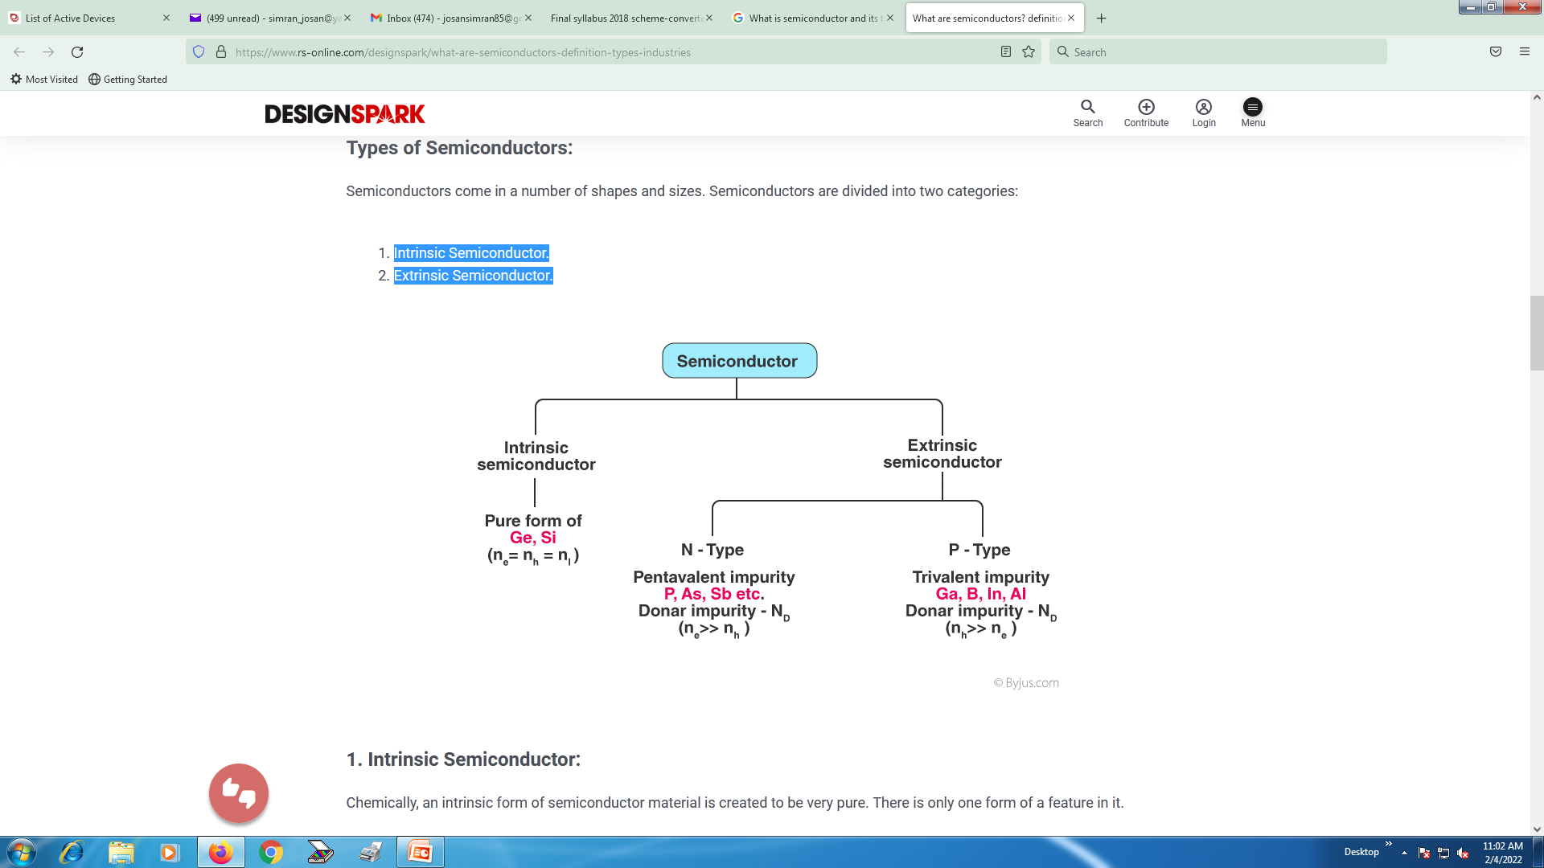

Slide 7
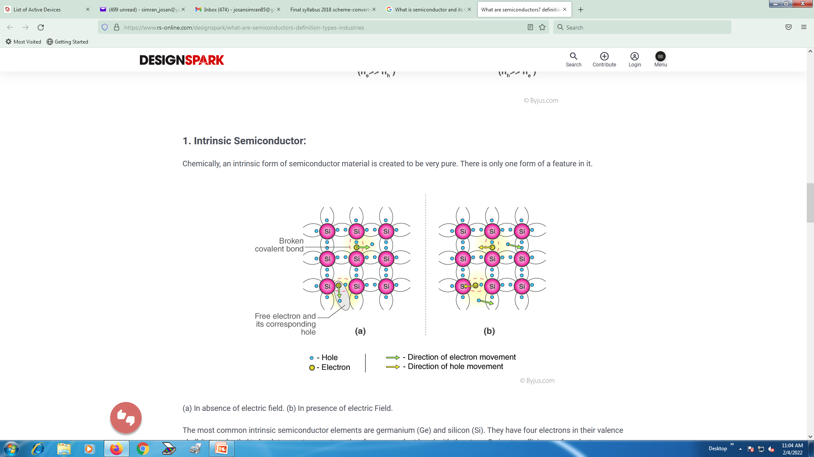

Slide 8
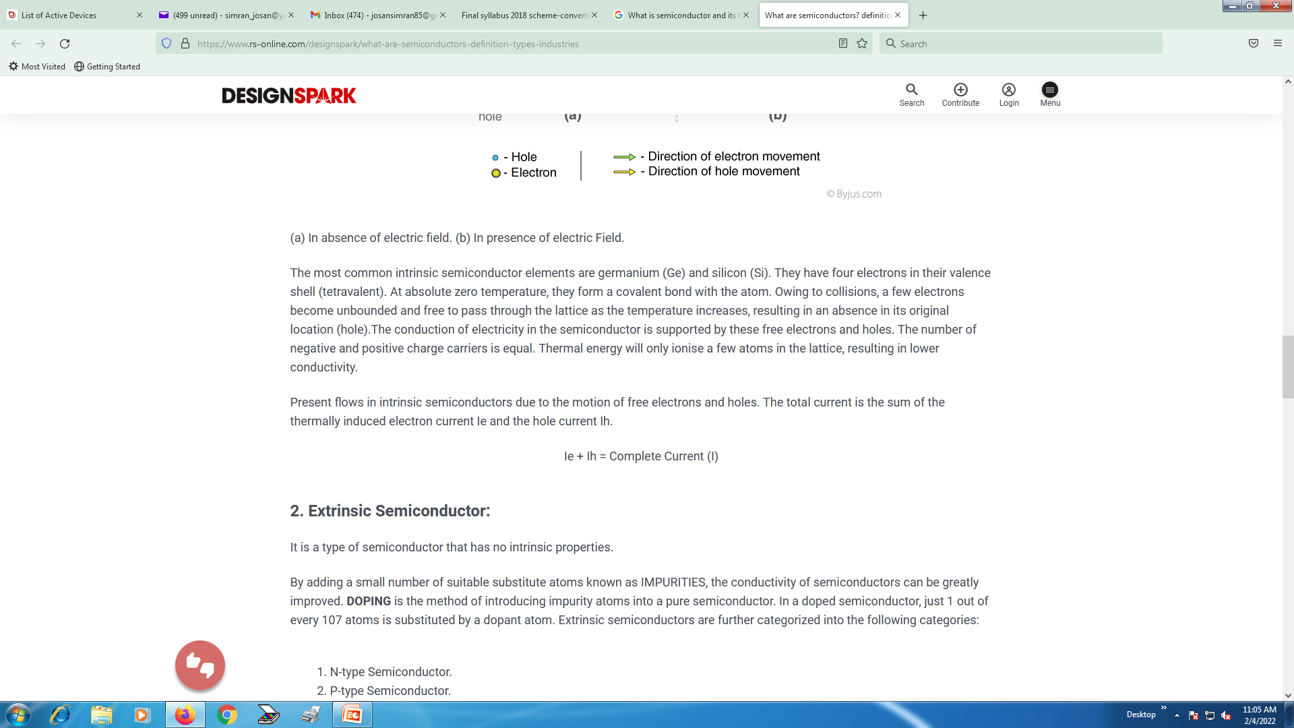

Slide 9
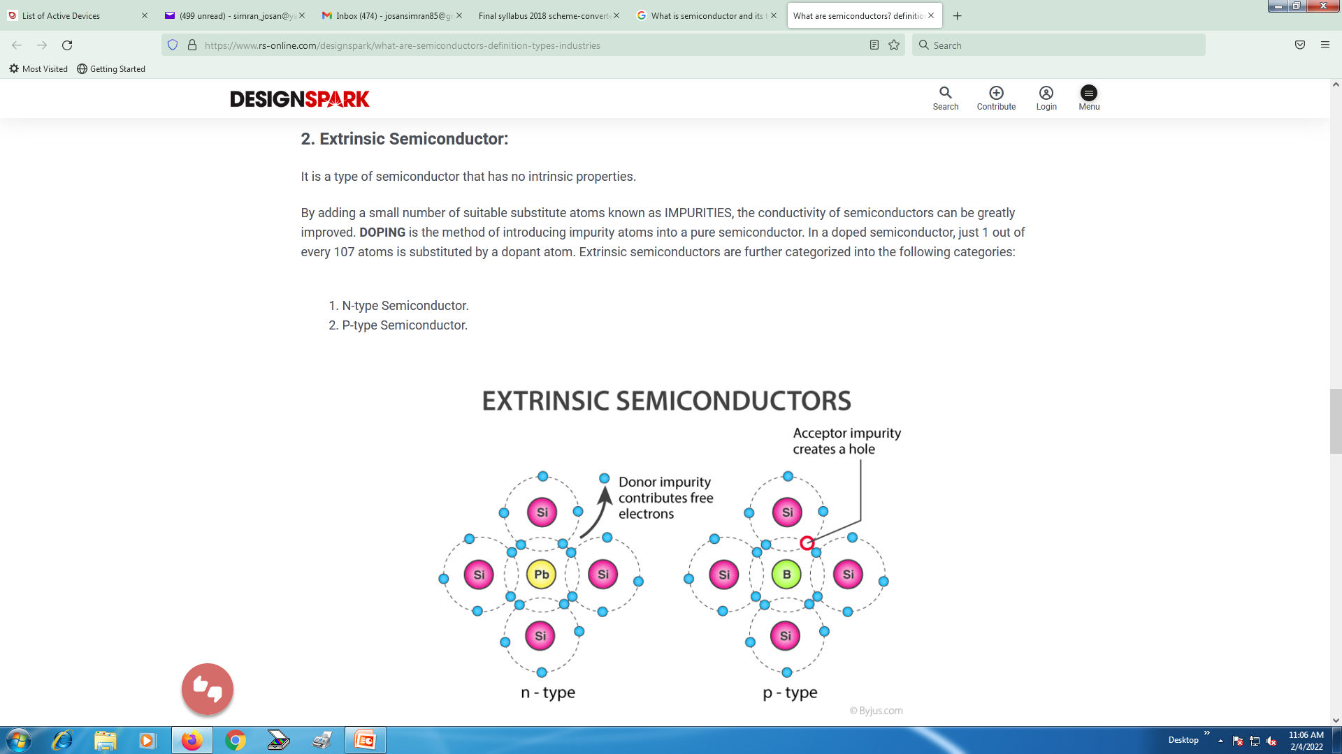

Slide 10
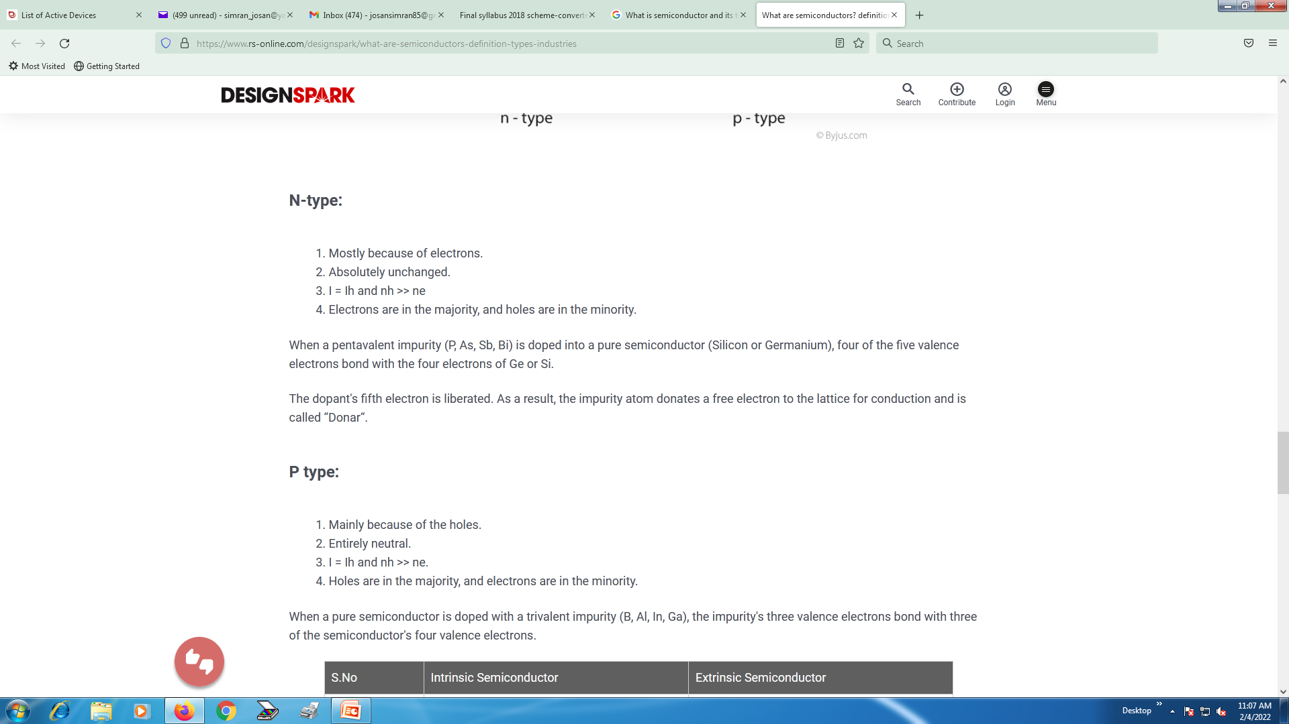

Slide 11
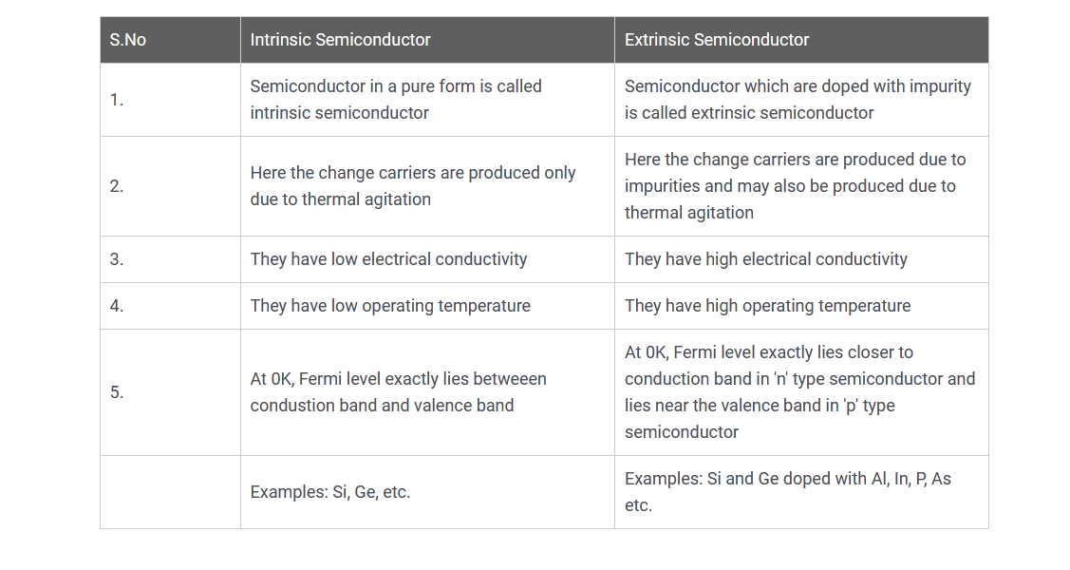

Slide 12
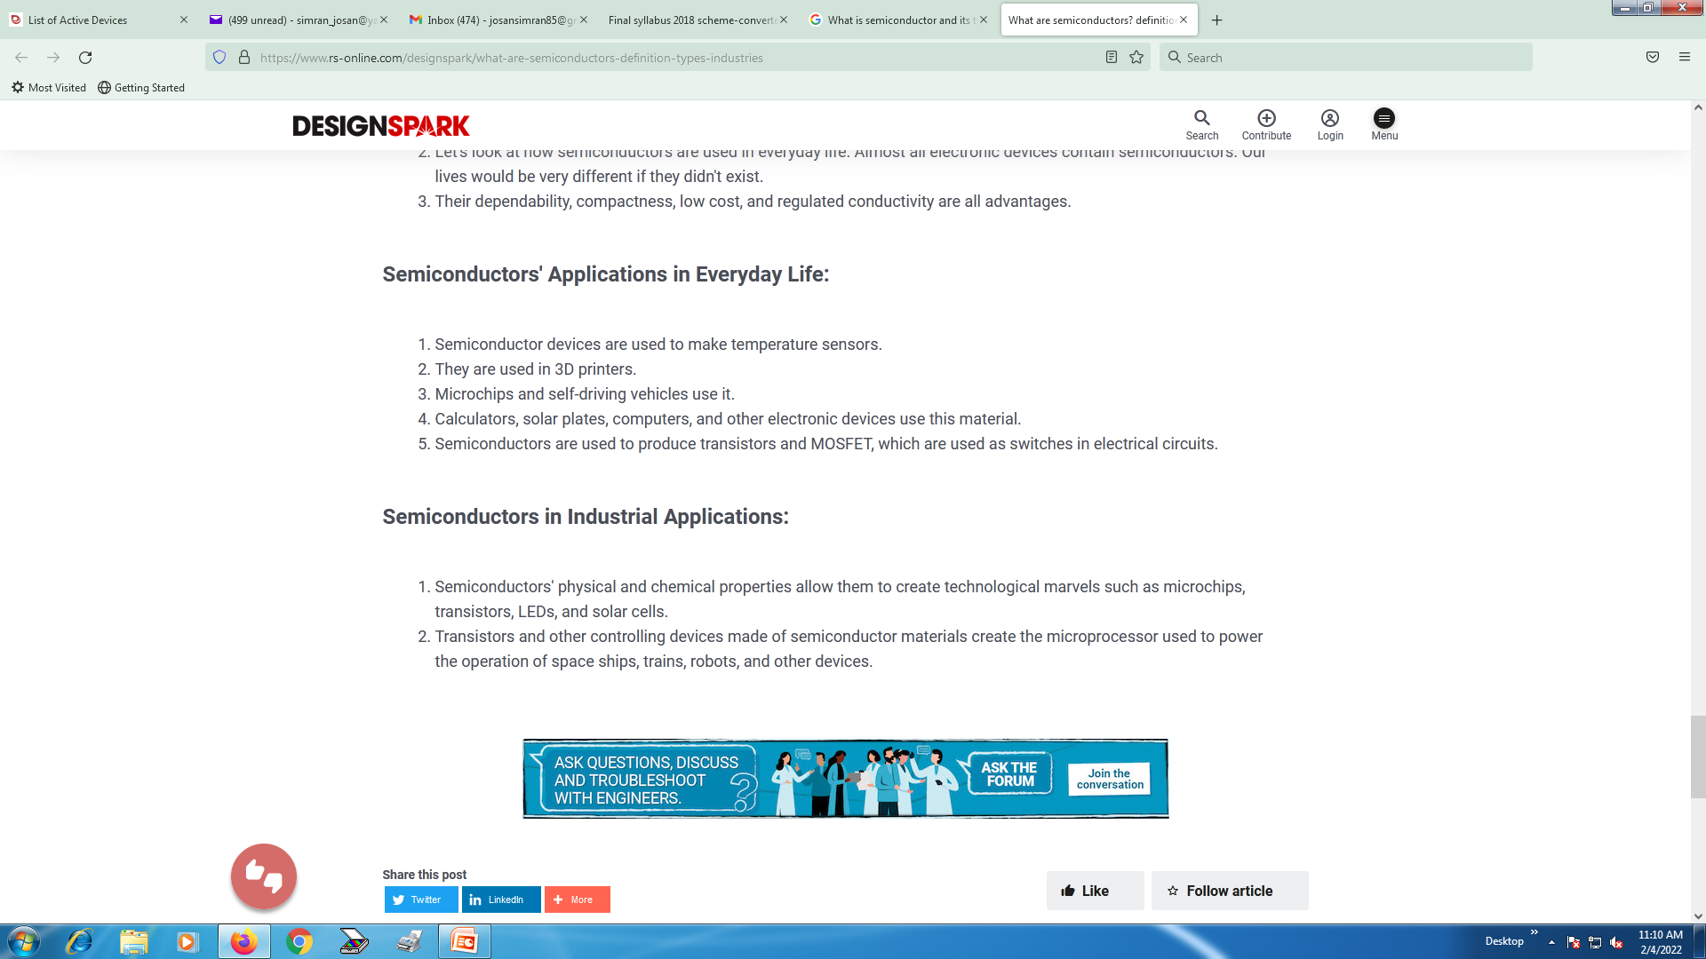
Applications

Slide 13
p-n junction diode
A p-n junction diode is two-terminal or two-electrode semiconductor device, which allows the electric current in only one direction while blocks the electric current in opposite or reverse direction
The p-n junction, which is formed when the p-type and n-type semiconductors are joined, is called as p-n junction diode.

Slide 14
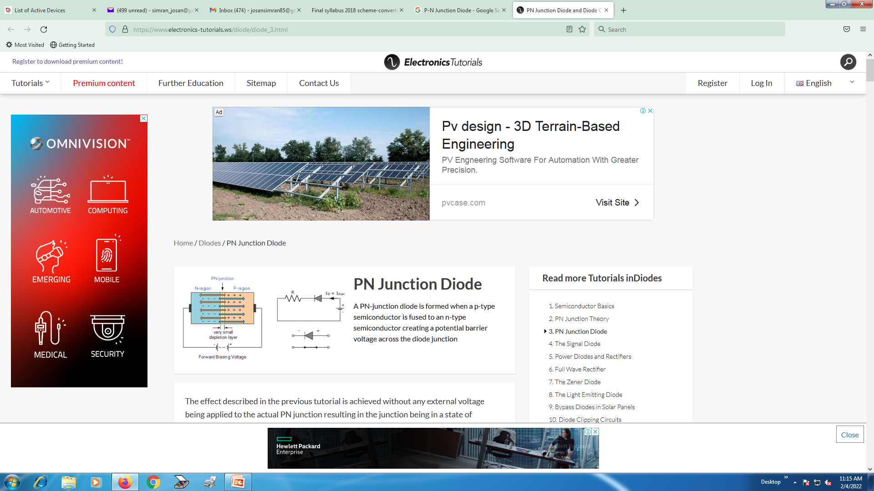

Slide 15
If a suitable positive voltage (forward bias) is applied between the two ends of the PN junction, it can supply free electrons and holes with the extra energy they require to cross the junction as the width of the depletion layer around the PN junction is decreased.

Slide 16
Then the depletion layer widens with an increase in the application of a reverse voltage and narrows with an increase in the application of a forward voltage.
This is due to the differences in the electrical properties on the two sides of the PN junction resulting in physical changes taking place.
One of the results produces rectification as seen in the PN junction diodes static I-V (current-voltage) characteristics.
Rectification is shown by an asymmetrical current flow when the polarity of bias voltage is altered as shown below.

Slide 17
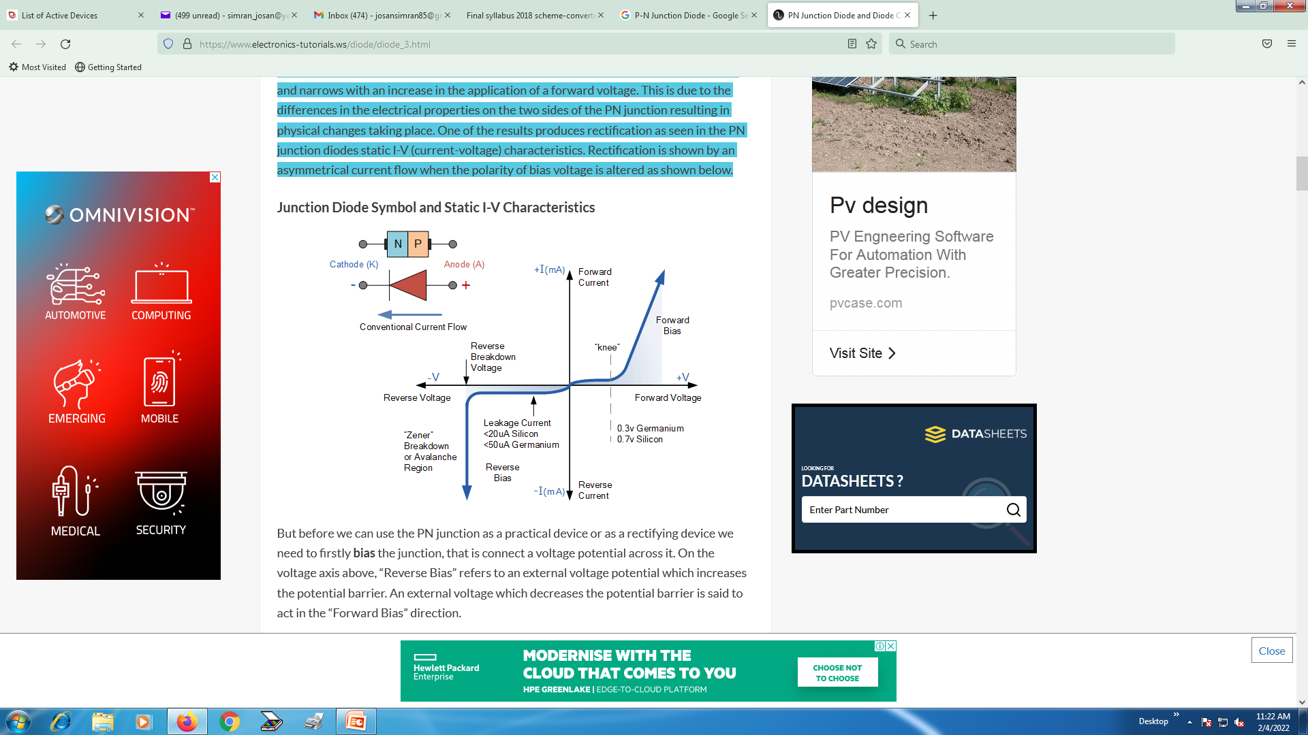

Slide 18
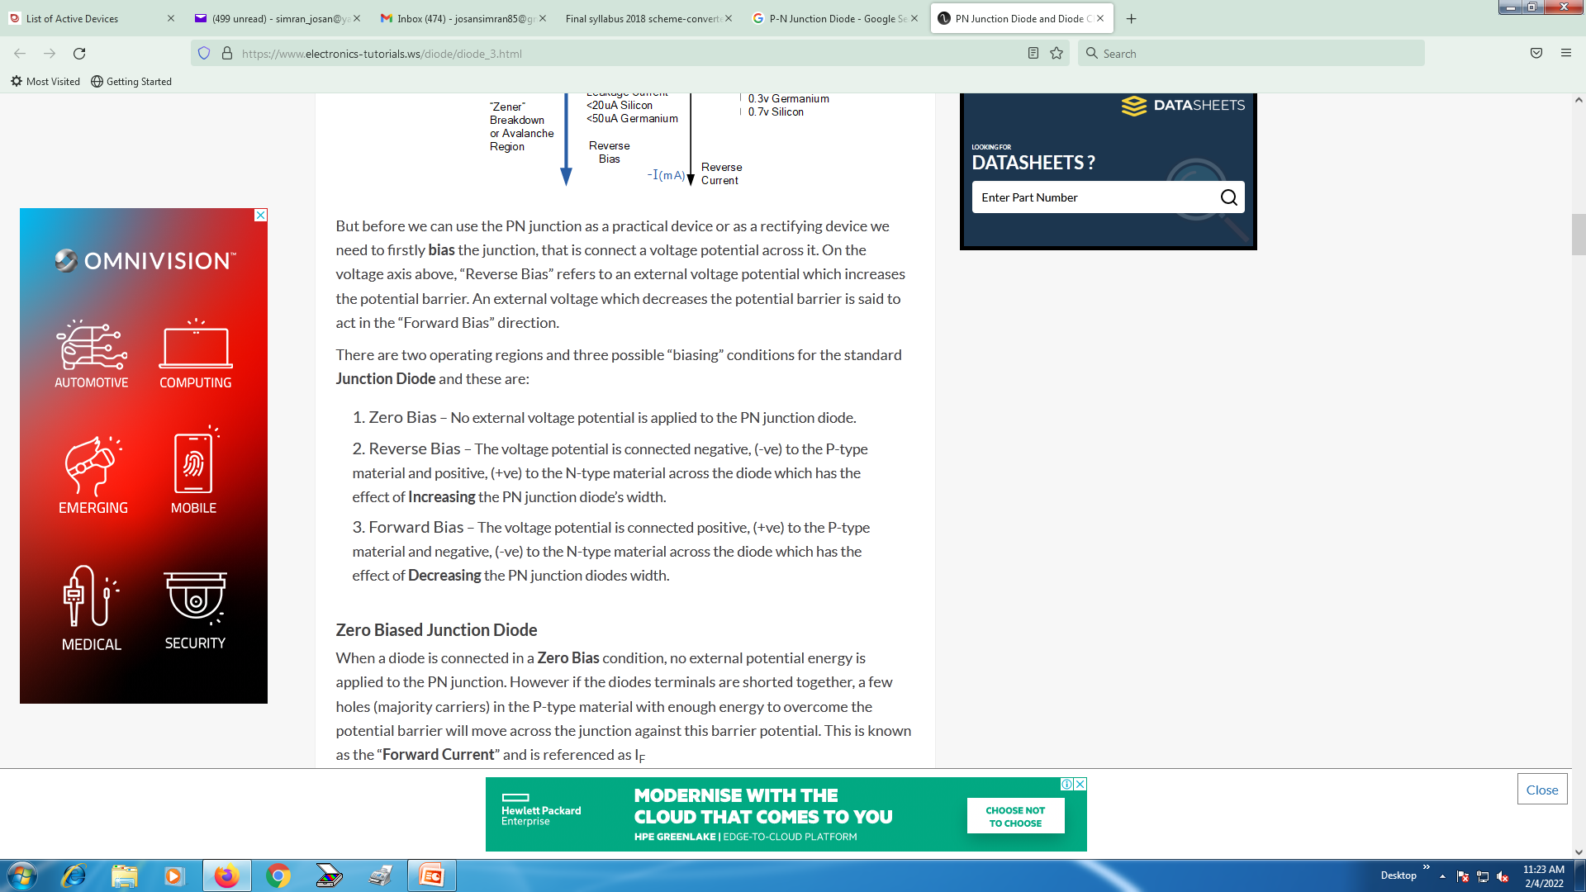

Slide 19
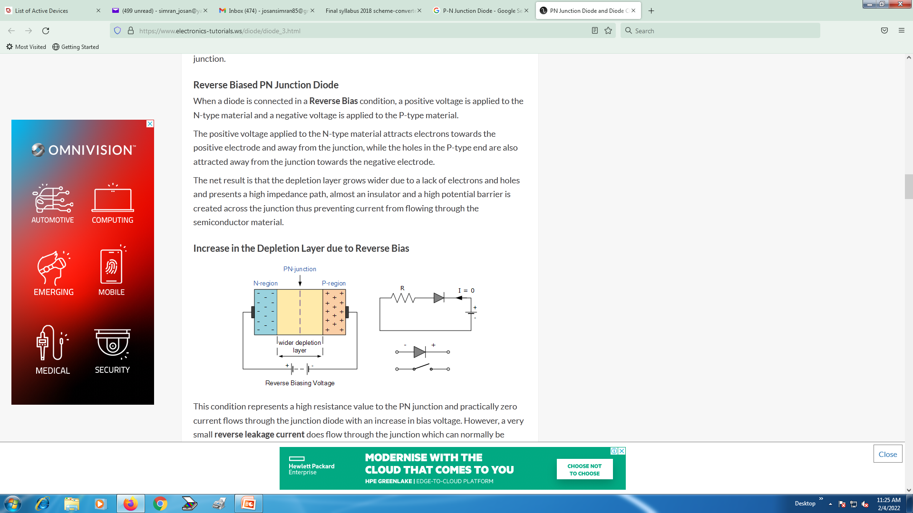

Slide 20
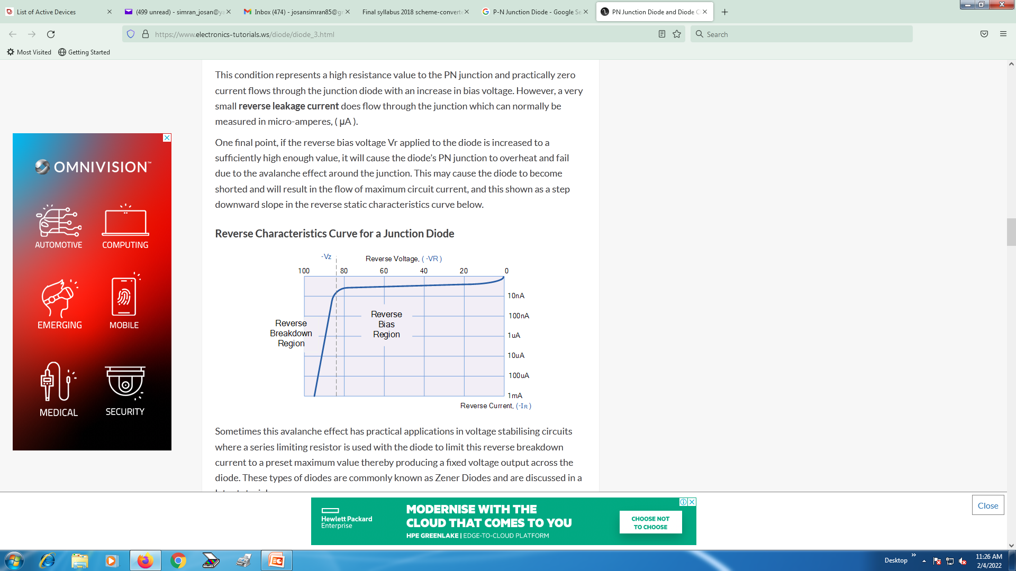

Slide 21


Slide 22
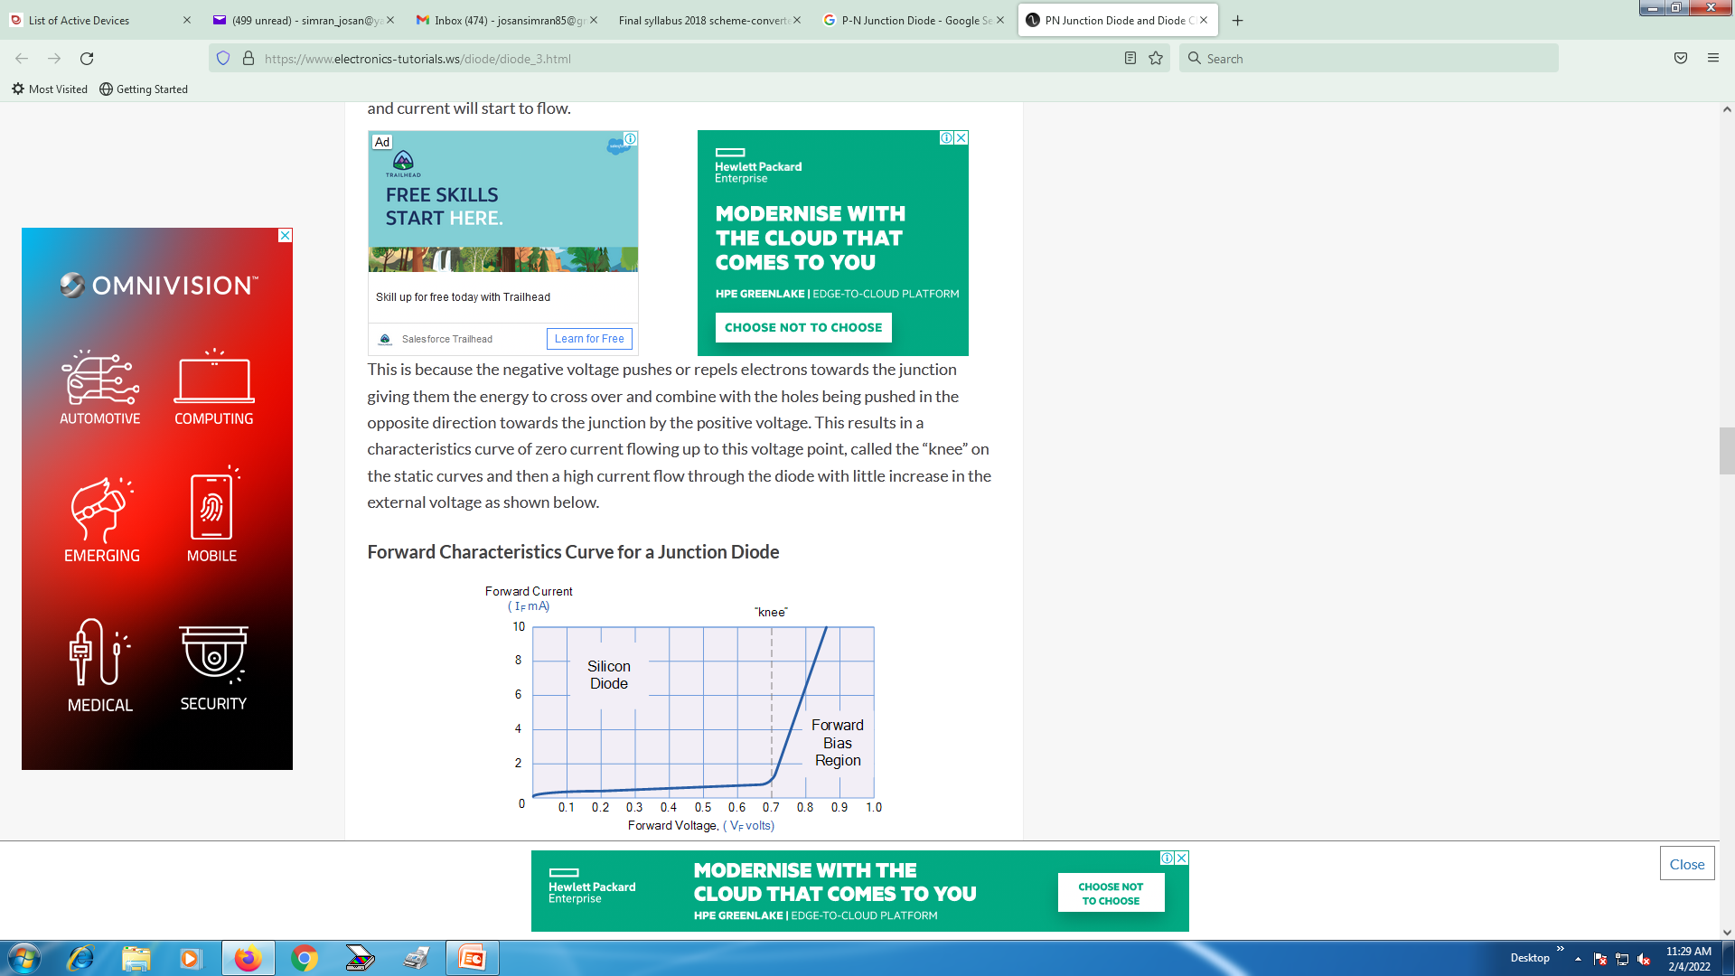

Slide 23
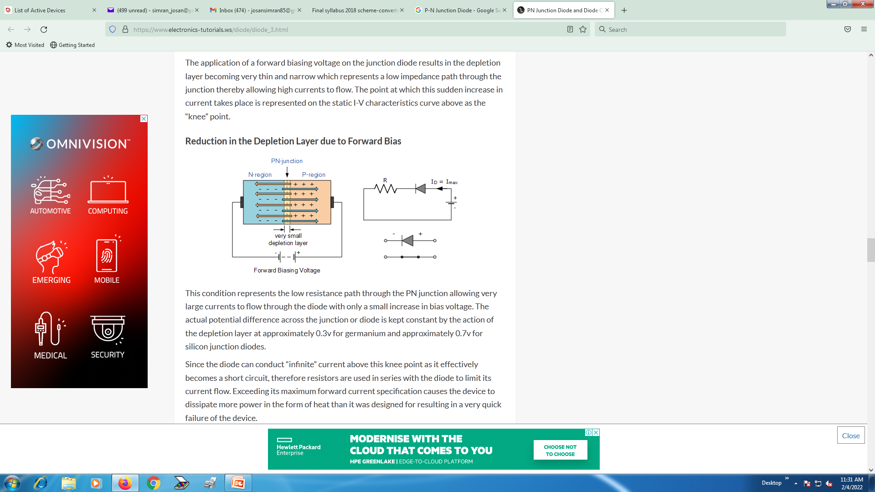

Slide 24
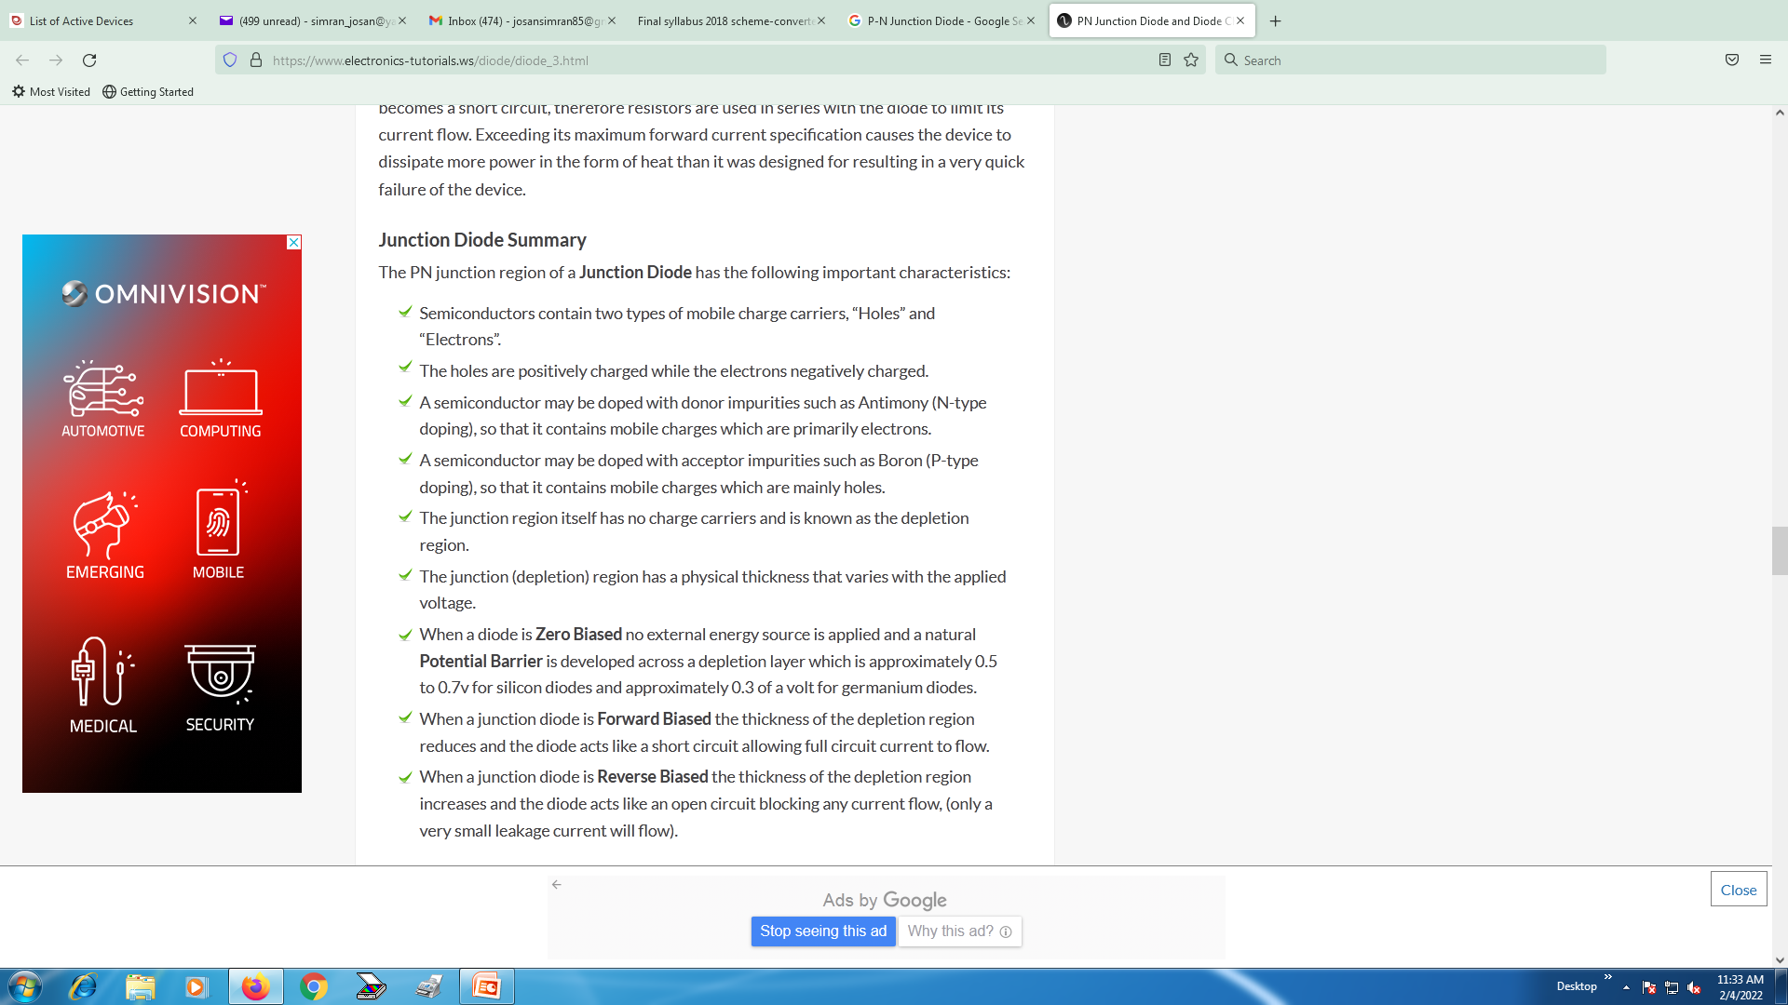

Slide 25
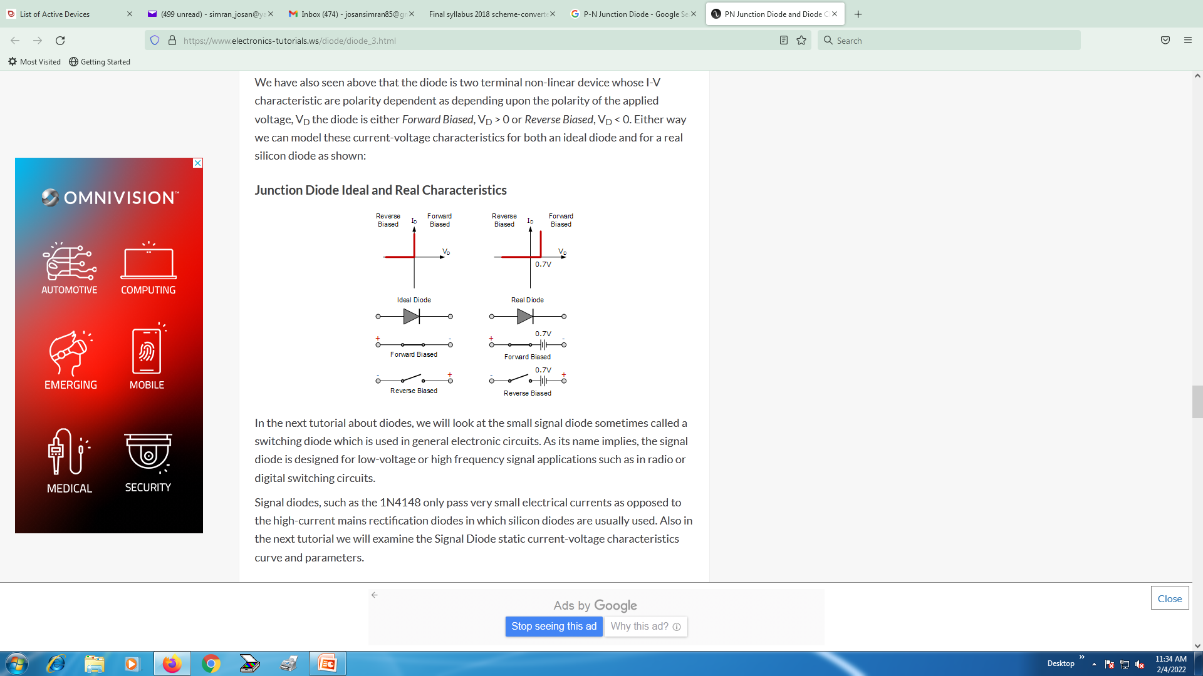

Slide 26
Zener Diode
A Zener diode is a special type of diode designed to reliably allow current to flow "backwards" when a certain set reverse voltage, known as the Zener voltage, is reached.

Slide 27
That is, in forward bias it allows current, and in reverse bias it blocks current. After this voltage has surpassed the breakdown point (in reverse bias), the diode falls in the Zener region, where it conducts without getting damaged. Current in this region is called avalanche current.

Slide 28
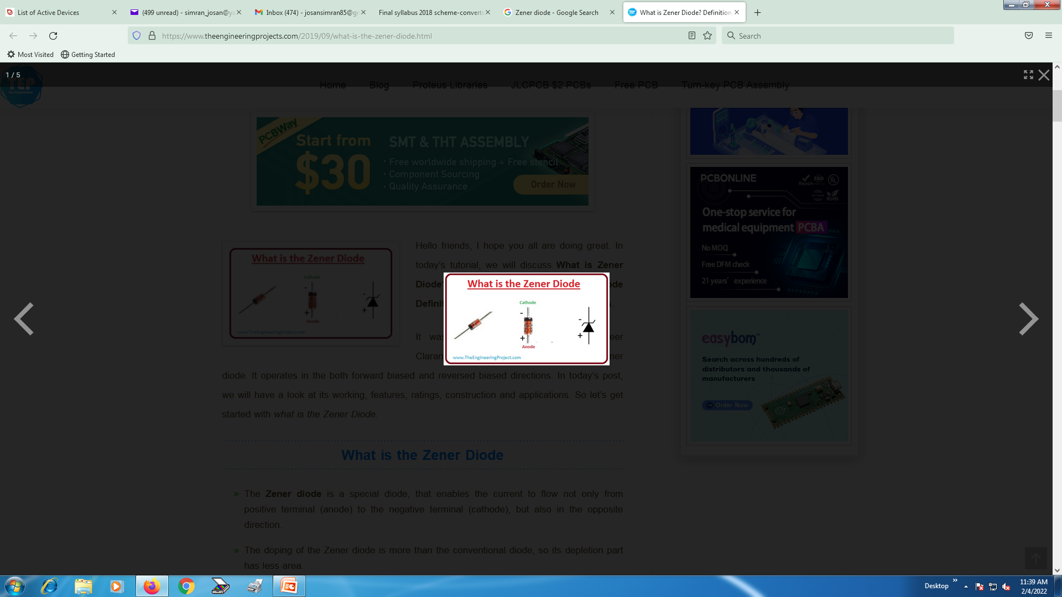

Slide 29
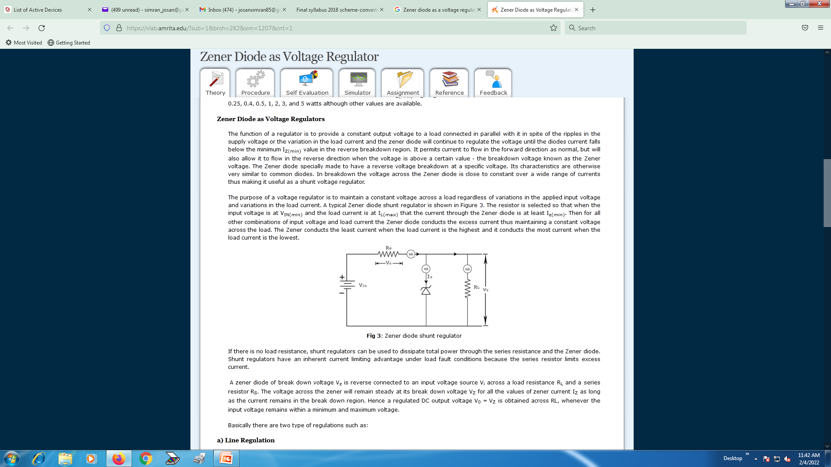

Slide 30
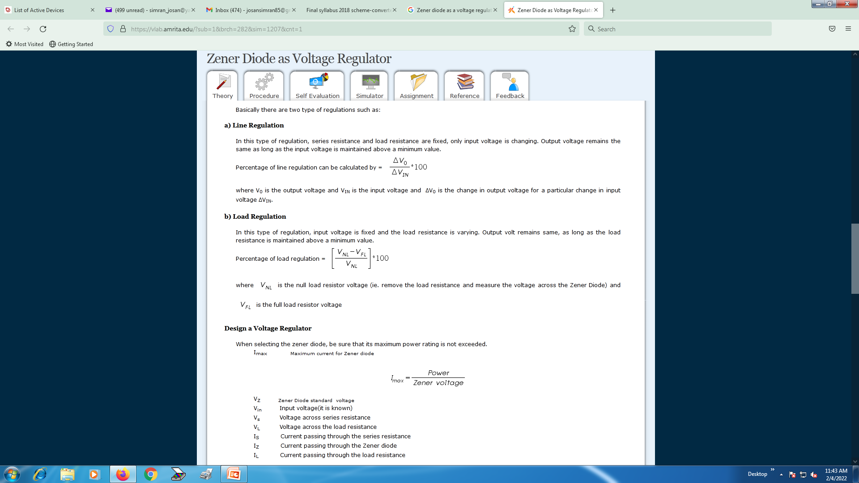

Slide 31
